Slide 1
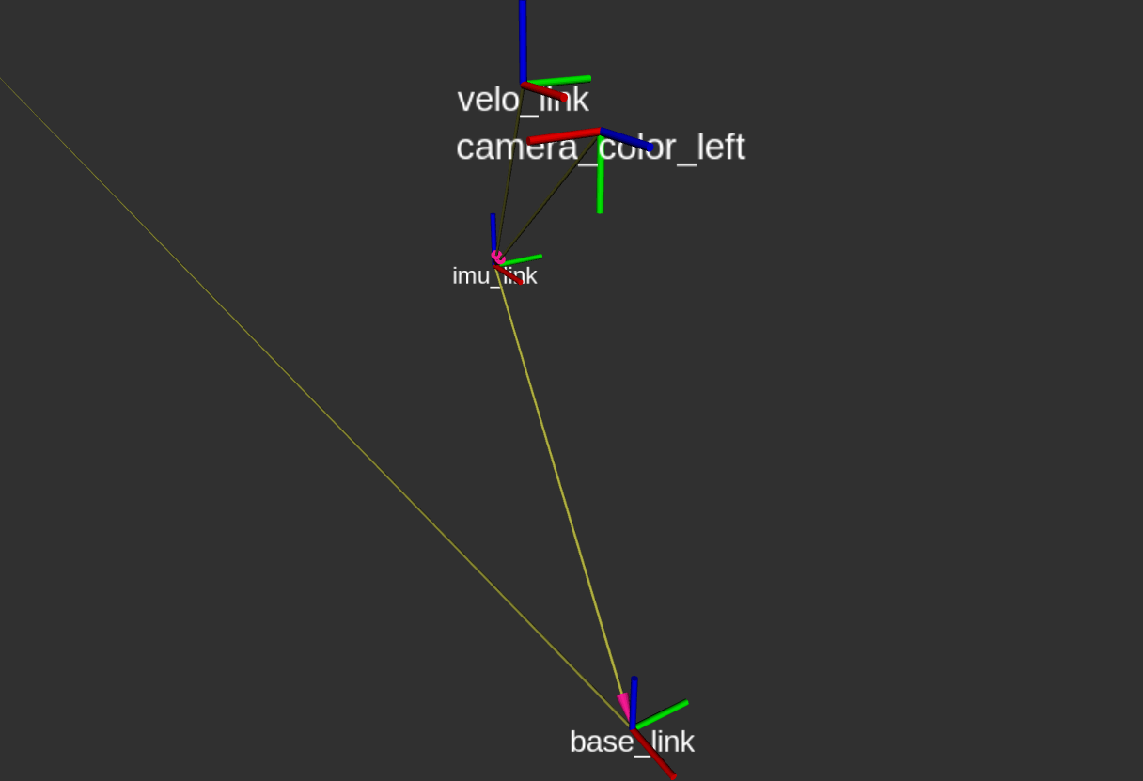
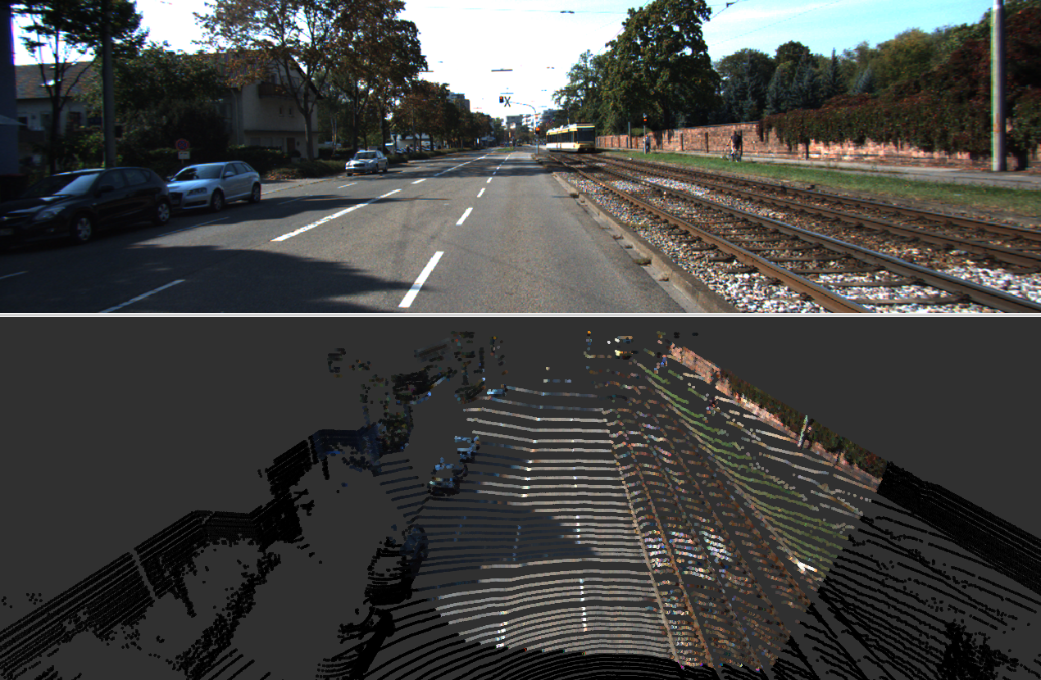
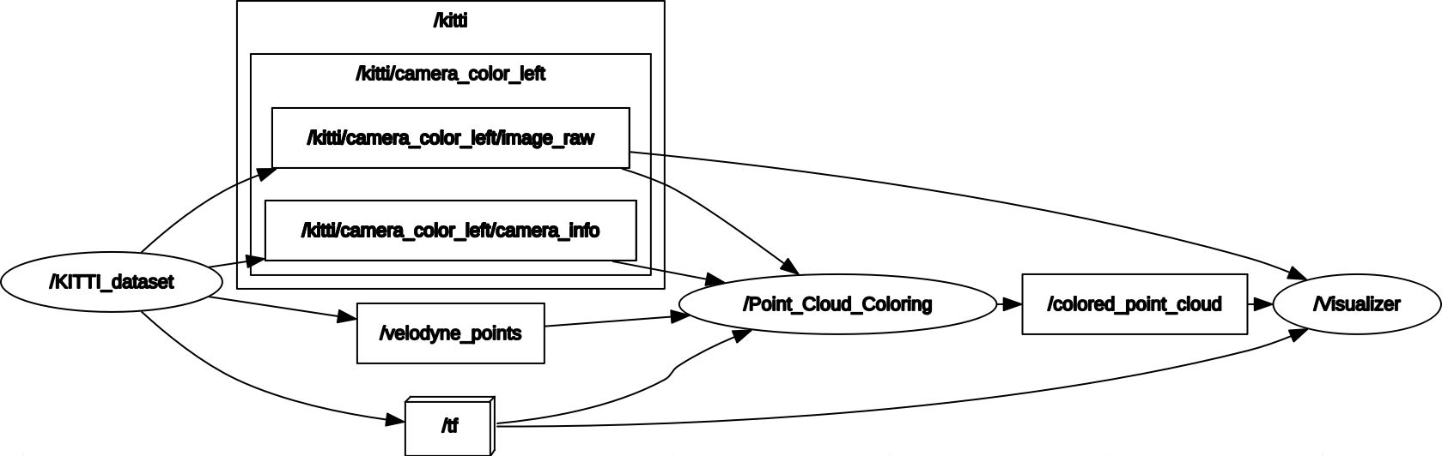

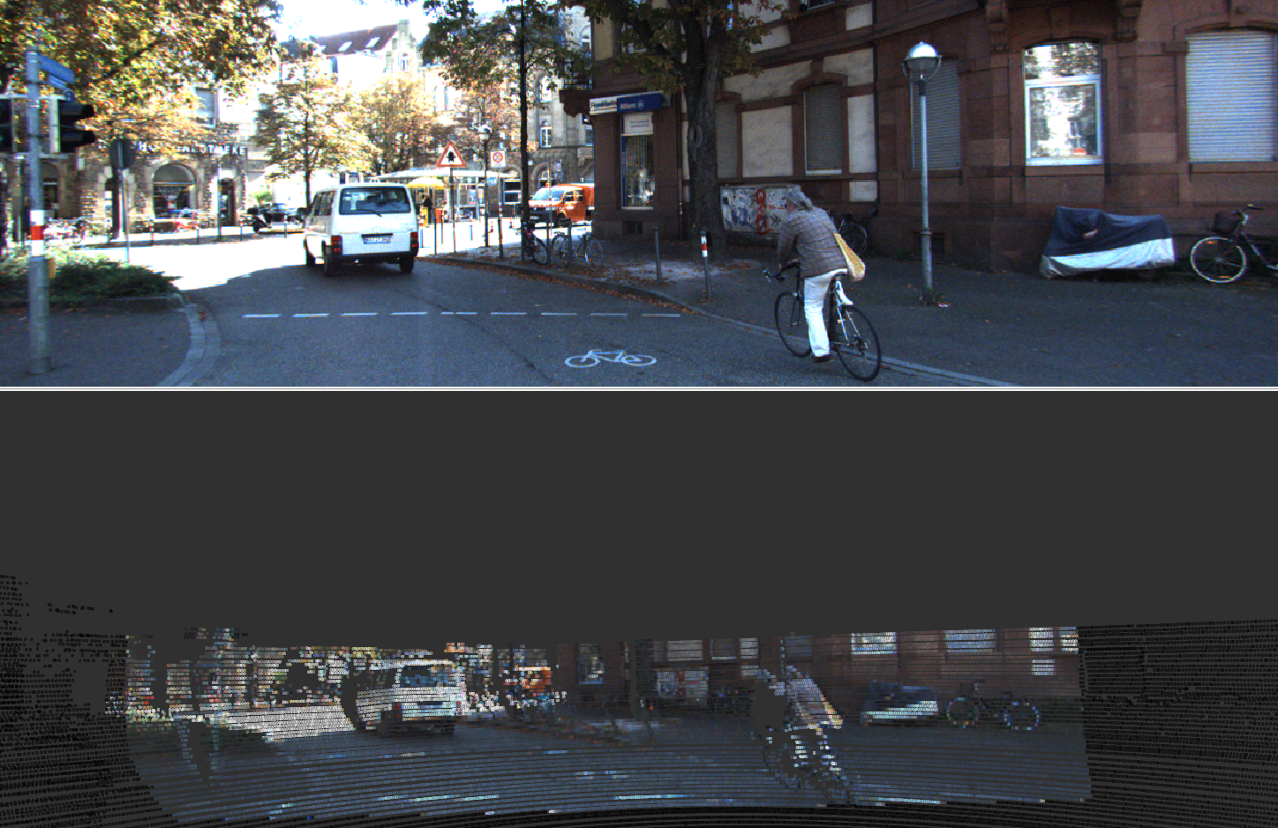

Enhancing self-driving cars “eyes” through sensor fusion
Pedro Martins (martinspedro@ua.pt)
Supervisor: Prof. António Neves (an@ua.pt)
Co-supervisor: Dr. Miguel Vidal Drummond (mvd@av.it.pt)
Co-supervisor: Dr. André Albuquerque (andre.albuquerque@pt.bosch.com)
Master’s Dissertation, 5th year, MIEET.
Abstract
Modern self-driving cars have been around for almost two decades, showing remarkable progress and powering the utopia of driverless future transportation. LIDAR, a common technology used by industry and researchers, provides precise depth information of the car surroundings but lacks robustness against multiple LIDAR interference, which can render a self-driving car nonoperational.
The work being presented shows an enhancement to the point cloud obtained using the LIDAR, by merging with the color captured with an RGB camera through a process called sensor fusion.
Fig 3- Rigid body transform representation for all the referentials used on this work. base_link is the car referential, imu_link, velo_link and camera_color_left the imu, LIDAR and camera referentials, respectively.
Work Motivation
LIDAR (Light Detection And Ranging), heavily relied by most of the autonomous driving systems nowadays hides a problem only revealed when multiple self-driving vehicles coexist in line-of-sight: interference. Multiple LIDAR interference happens when a first LIDAR receives a pulse (directly or indirectly) from a second LIDAR, causing a wrong depth measurement and therefore compromising the capability of the car to recognize its environment accurately and drive safely.
Implementation
The enhancing of depth data from LIDAR using color from RGB camera is a challenge commonly know as point cloud coloring, which can be achieved by sensor fusion: merging two different data sources under the same referential. To merge video with point clouds the following steps were followed:
Synchronize information from camera (video stream) and LIDAR (point cloud);
Compute the Rigid Transform between the LIDAR and Camera referential (figure 3);
Convert the Point Cloud data from the LIDAR referential to the Camera referential;
Project 3D voxels to the image pixels, while filtering for voxels outside the camera FOV (Field Of View);
Color voxels that have a correspondence to the pixels in the camera FOV.
All the steps described below are implemented on a single ROS node, Point_Cloud_Coloring, shown on figure 4. The data used is provided by the Kitti dataset.
Fig 1- On top, a frame of an RGB camera stream. On bottom, a colored point cloud, obtained color and depth data fusion. The black dots represent LIDAR measurements that are outside the camera FOV an therefore cannot be matched with an RGB triplet.
Fig 4- Node and active topic diagram for the sensor fusion implementation. The dataset contains camera, LIDAR and their Rigid Transform data, which is used to perform point cloud coloring, as show in figure 1 and 2. /colored_point_cloud is the quasi-real time colored point cloud.
References
G. Kim, et al., "An Experiment of Mutual Interference between Automotive LIDAR Scanners, 2015, "International Conference on Information Technology - New Generations, Las Vegas, p. 680-685
A. Geiger, et al, “Vision meets Robotics: The KITTI Dataset”, 2013, International Journal of Robotics Research (IJRR)
Fig 2- On top, a frame of an RGB camera stream. On bottom, a colored point cloud, obtained color and depth data fusion.

